Slide 1
GALE HEALTH AND WELLNESS
Notes:
Use this slide to introduce yourself and the presentation.
Notes throughout this presentation provide instruction around areas to customize for your specific audience, as well as speaker notes to make the process of presenting easier. Feel free to hide slides and select what content to feature if you are given shorter speaking times, or if you’re able to take attendees live into Gale Health and Wellness

Slide 2
GALE HEALTH AND WELLNESS
RELIABLE CONTENT
Full text medical journals, news & magazines, reference works, and multimedia materials focused on diseases, disorders, diagnostics and treatments.
SIMPLE ORGANIZATION
Topic Page organization curates content into one landing-point to kick start exploration.
EFFECTIVE RESEARCH TOOLS
Get Link, Translate, Text Manipulation, Highlights and Notes, and Google/Microsoft Integrations are some of the many tools to create an effective learning experience.
Notes:
Gale Health and Wellness supports patrons with research into health-related issues, from current disease and disorder information to in-depth coverage of alternative medical practices.
Users will find a vast array of resources focused on key topics like diabetes, antioxidants, Covid-19, etc.

Slide 3
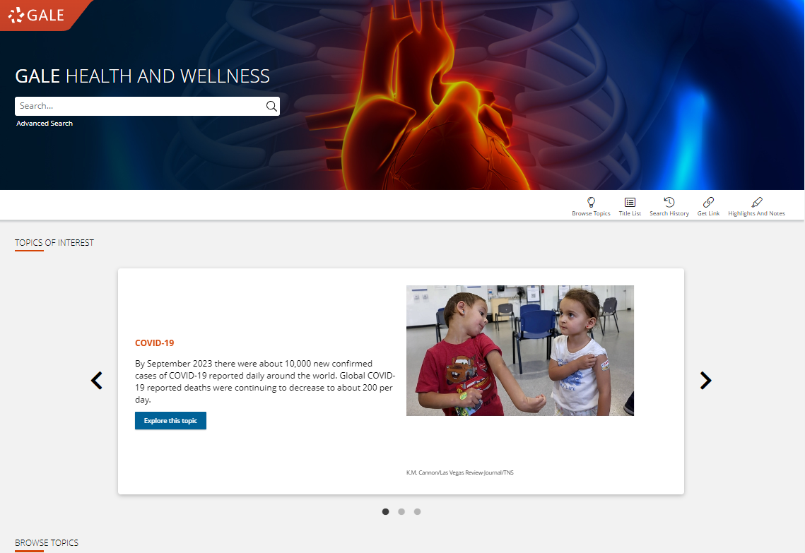
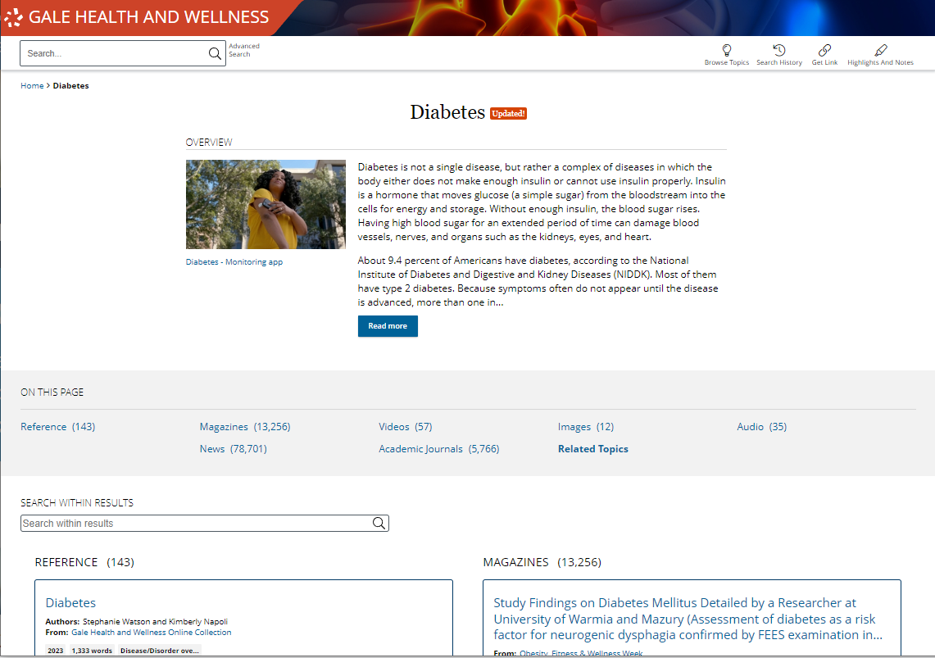
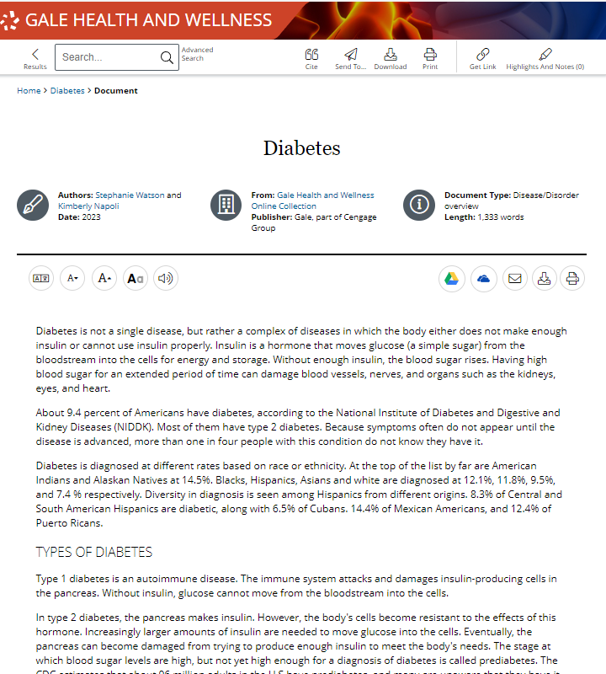
SIMPLE ACCESS
Anytime
Anywhere
Any Device
Without Ads or Paywalls
Notes:
All of the content in Gale Health and Wellness can be accessed by you and your patrons 24/7 on any device, no matter where you are. Additionally, Gale Health and Wellness is an ad-free environment that provides full-text access without paywalls.

Slide 4
DISCOVER PREMIUM RESOURCES

Slide 5
SEARCH OR BROWSE
EXPLORE CONTENT
VIEW AND SHARE
Notes:
It’s easy to access all the premium resources within Gale Health and Wellness by browsing or searching for topics of interest, exploring content organized by type, and then clicking individual result titles to view and use recommended resources, business plans, journals, videos, directories, and more.

Slide 6
SEARCH
Enter simple search terms
Notes:
To perform a basic search, just enter key terms related to topics of interest in the search box on the homepage or at the top of every page throughout Gale Health and Wellness.

Slide 7
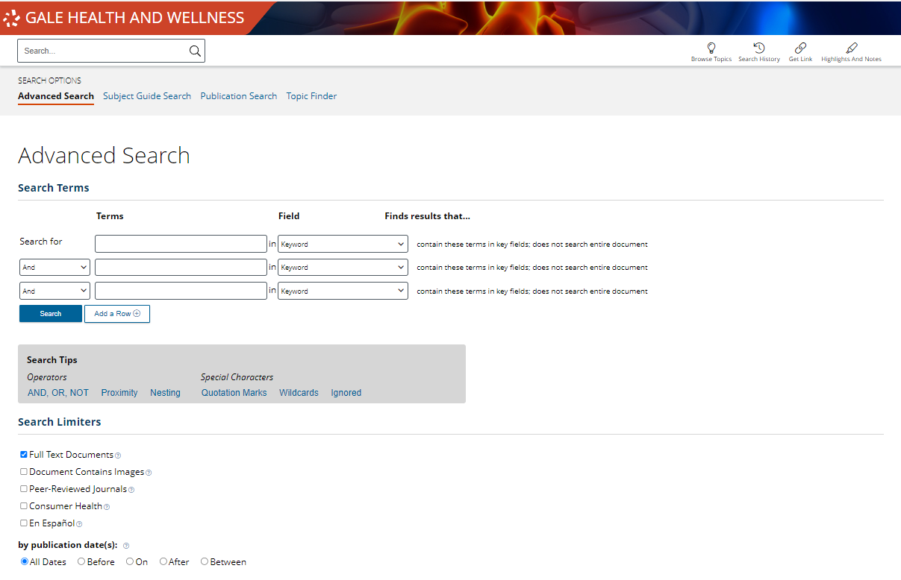
SEARCH
Enter simple search terms
Or, customize multiple fields and limiters
Notes:
You can also run a more targeted or customized search by clicking the Advanced Search option beneath or to the side of the basic search box. Advanced Search provides the option to select specific search fields (For example, publication title if you’re looking for articles in a specific journal) and combine these fields/terms in various ways (for instance using NOT if you want articles about one subject, but are NOT interested in any articles that also focus on a related subject that is not relevant to what you are researching). If you scroll down the page, you can also include search options to limit results by document type, date, and more.

Slide 8
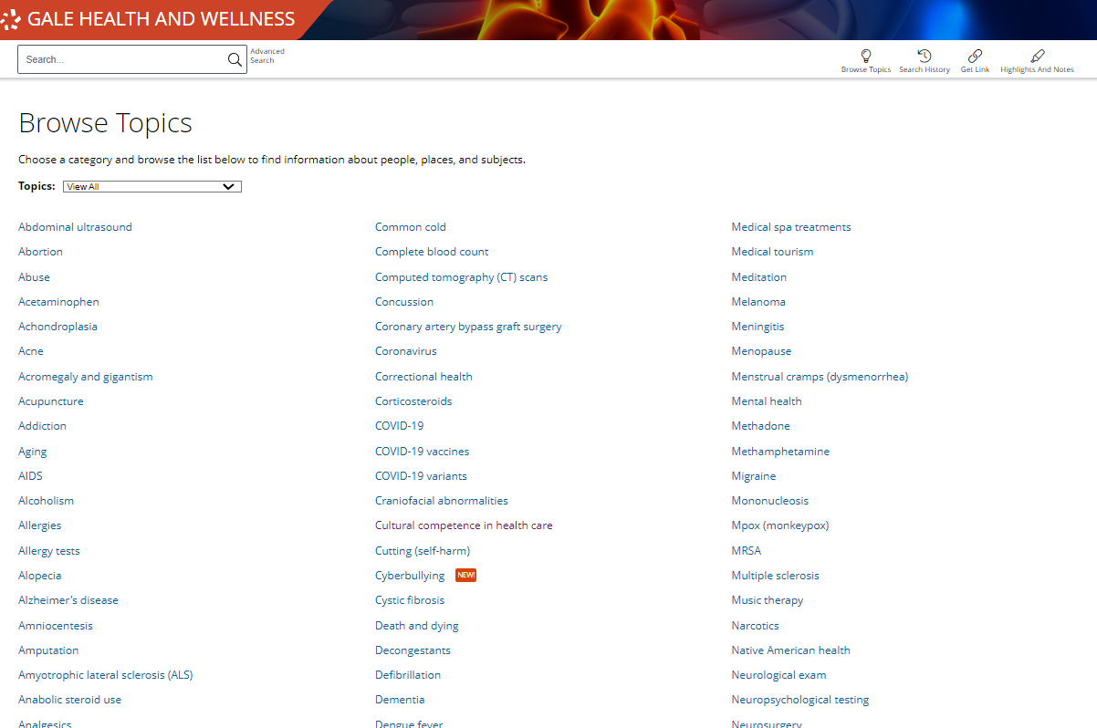
BROWSE
Browse Topics
Notes:
In addition to searching, Gale Health and Wellness is designed to make it easy for your patrons to browse for topics of interest. Simply click the Browse Topics option in the upper right corner of the homepage and on many other pages throughout the resource to access a list of all topics for which there are curated pages. If desired, you can use the drop-down menu at the top of this page to view pages based on categories of interest.
When you click the title of one of the topics, you’ll be taken to a results list focused on your topic. Simply click the header for a content type to view all results of that format, and click the title of an individual result to view that specific piece of content.
Note that if you do not see a topic related to something of interest, that just means that you will need to run a basic or advanced search within Gale Health and Wellness to view any available results (it doesn’t mean content on that topic is unavailable).

Slide 9
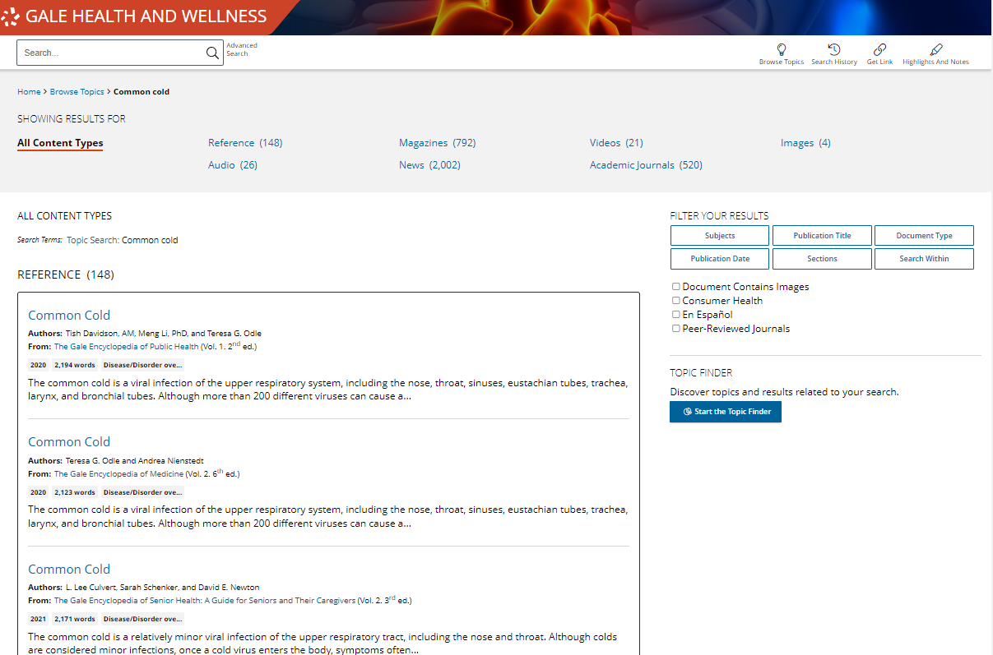
EXPLORE AND FILTER RESULTS
EXAMINE CONTENT TYPES
Select a Content Type to focus on results within that format
Notes:
Once you run a search you’ll find options to further pinpoint results of interest. At the top of the page, you can click to view results of specific types (news, magazines, etc.) depending on what’s available for your search.

Slide 10
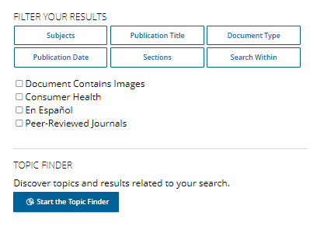
EXPLORE AND FILTER RESULTS
EXAMINE CONTENT TYPES
Select a Content Type to focus on results within that format
NARROW RESULTS
Limit by publication title, subjects, peer-reviewed journals, etc.
Notes:
In the Filter Your Results portion on the right-hand side of the results, you’ll find options to limit your search results further based on publication date, subjects, document types, etc. Simply click one of the filtering options, check the box next to specific filters of interest, and then click to Apply the filter.
Note that these are also great options to point out to patrons who are running very broad searches.

Slide 11
EXPLORE AND FILTER RESULTS
EXAMINE CONTENT TYPES
Select a Content Type to focus on results within that format
NARROW RESULTS
Limit by publication title, subjects, peer-reviewed journals, etc.
VIEW INDIVIDUAL SOURCES
See document information like date, publication, and word count before selecting it
Notes:
When you find an item that you’d like to view, simply click the title of the result to access the content.

Slide 12
EXPLORE CONTENT
Full-Text Reference Works
NEWS
MULTIMEDIA MATERIALS
Spanish Editions
Notes:
Depending on the topic you search or browse, you will find a wide variety of content types.

Slide 13
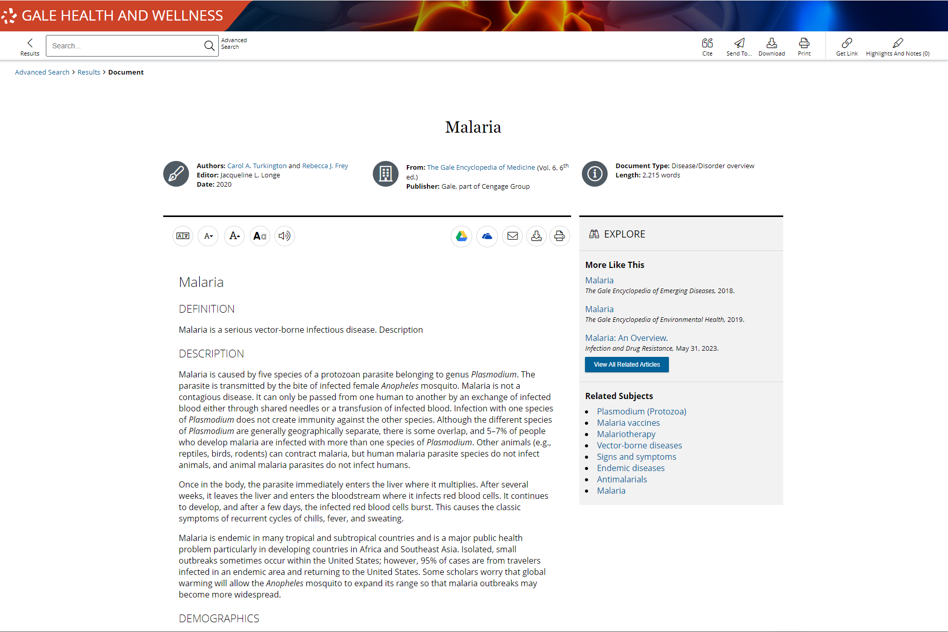
EXPLORE CONTENT: FULL-TEXT REFERENCE WORKS
Full-Text Reference Works
A broad collection of premier full-text reference works, including Gale exclusives such as The Gale Encyclopedia of Medicine, The Gale Encyclopedia of Surgery and Medical Tests, and The Gale Encyclopedia of Diets
Notes:
Use these reference works and other scholarly medical journals to easily navigate content on disease and conditions; drugs; diagnostics and test; and therapies, treatments and surgeries.

Slide 14
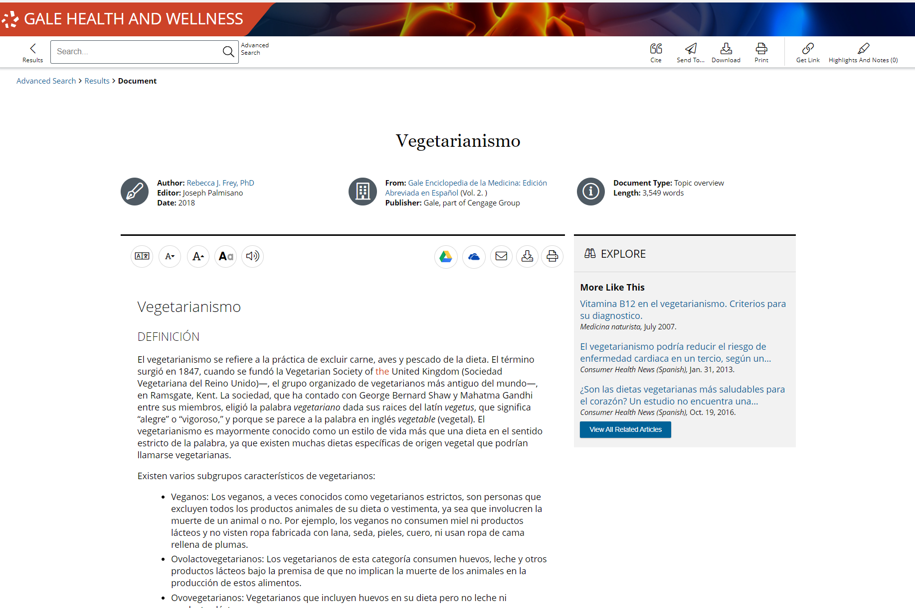
EXPLORE CONTENT: SPANISH EDITIONS
Spanish Editions
Use the filter results tool to find Spanish language content. Browse reference content, news, videos, magazines, and academic journals in Spanish.
Notes:
After a general search and in advance search, filter your search results to Spanish language content.

Slide 15
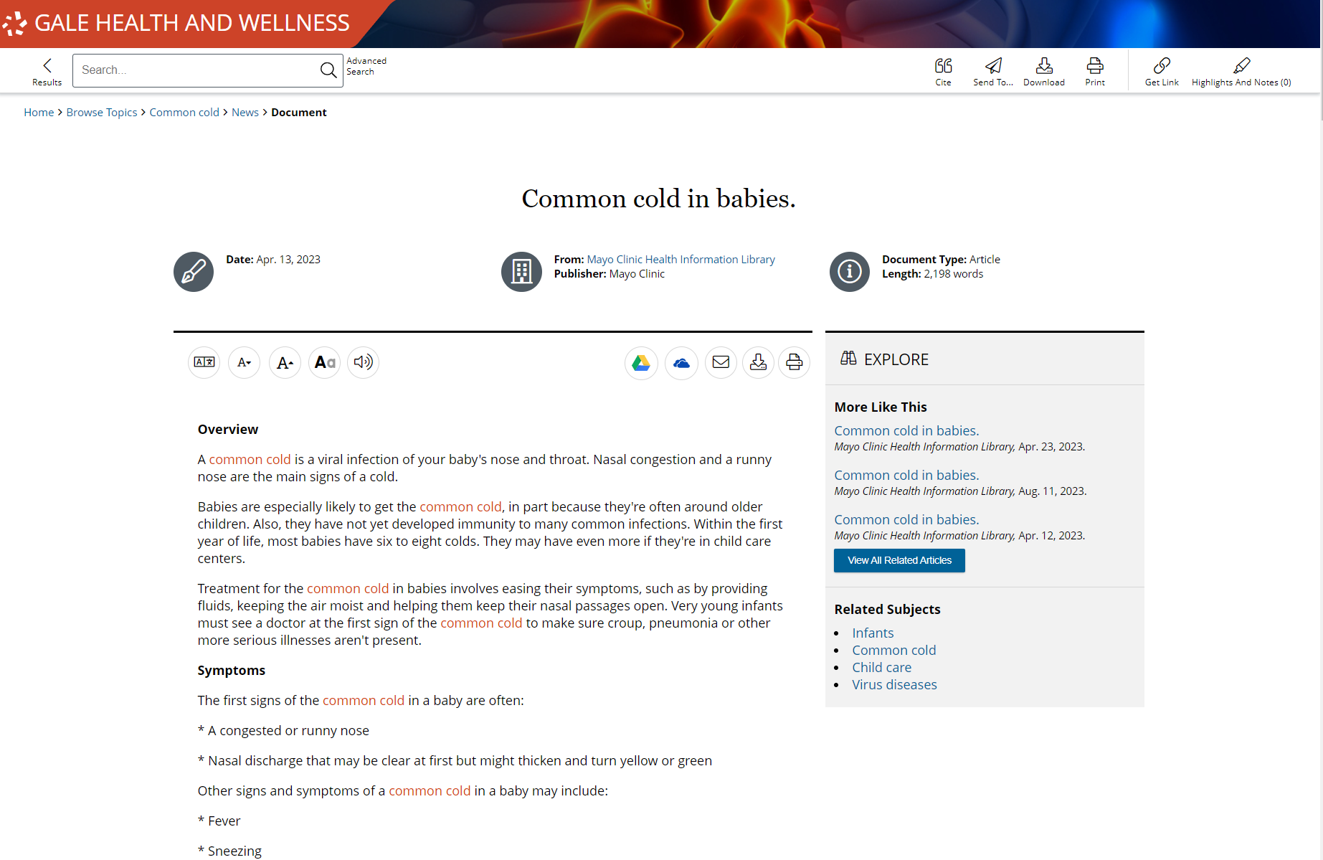
EXPLORE CONTENT: NEWS
NEWS
Provide recent coverage, in-depth analysis, and both real-world and academic perspectives
New content is being added daily from key publishers including The Mayo Clinic Health and Information Library, The Washington Post, The New York Times, and Pediatrics Week.
Notes:
Periodical feeds within Gale resources update multiple times per day, so you can be sure you’ll find recent coverage of trending topics from authoritative sources.

Slide 16
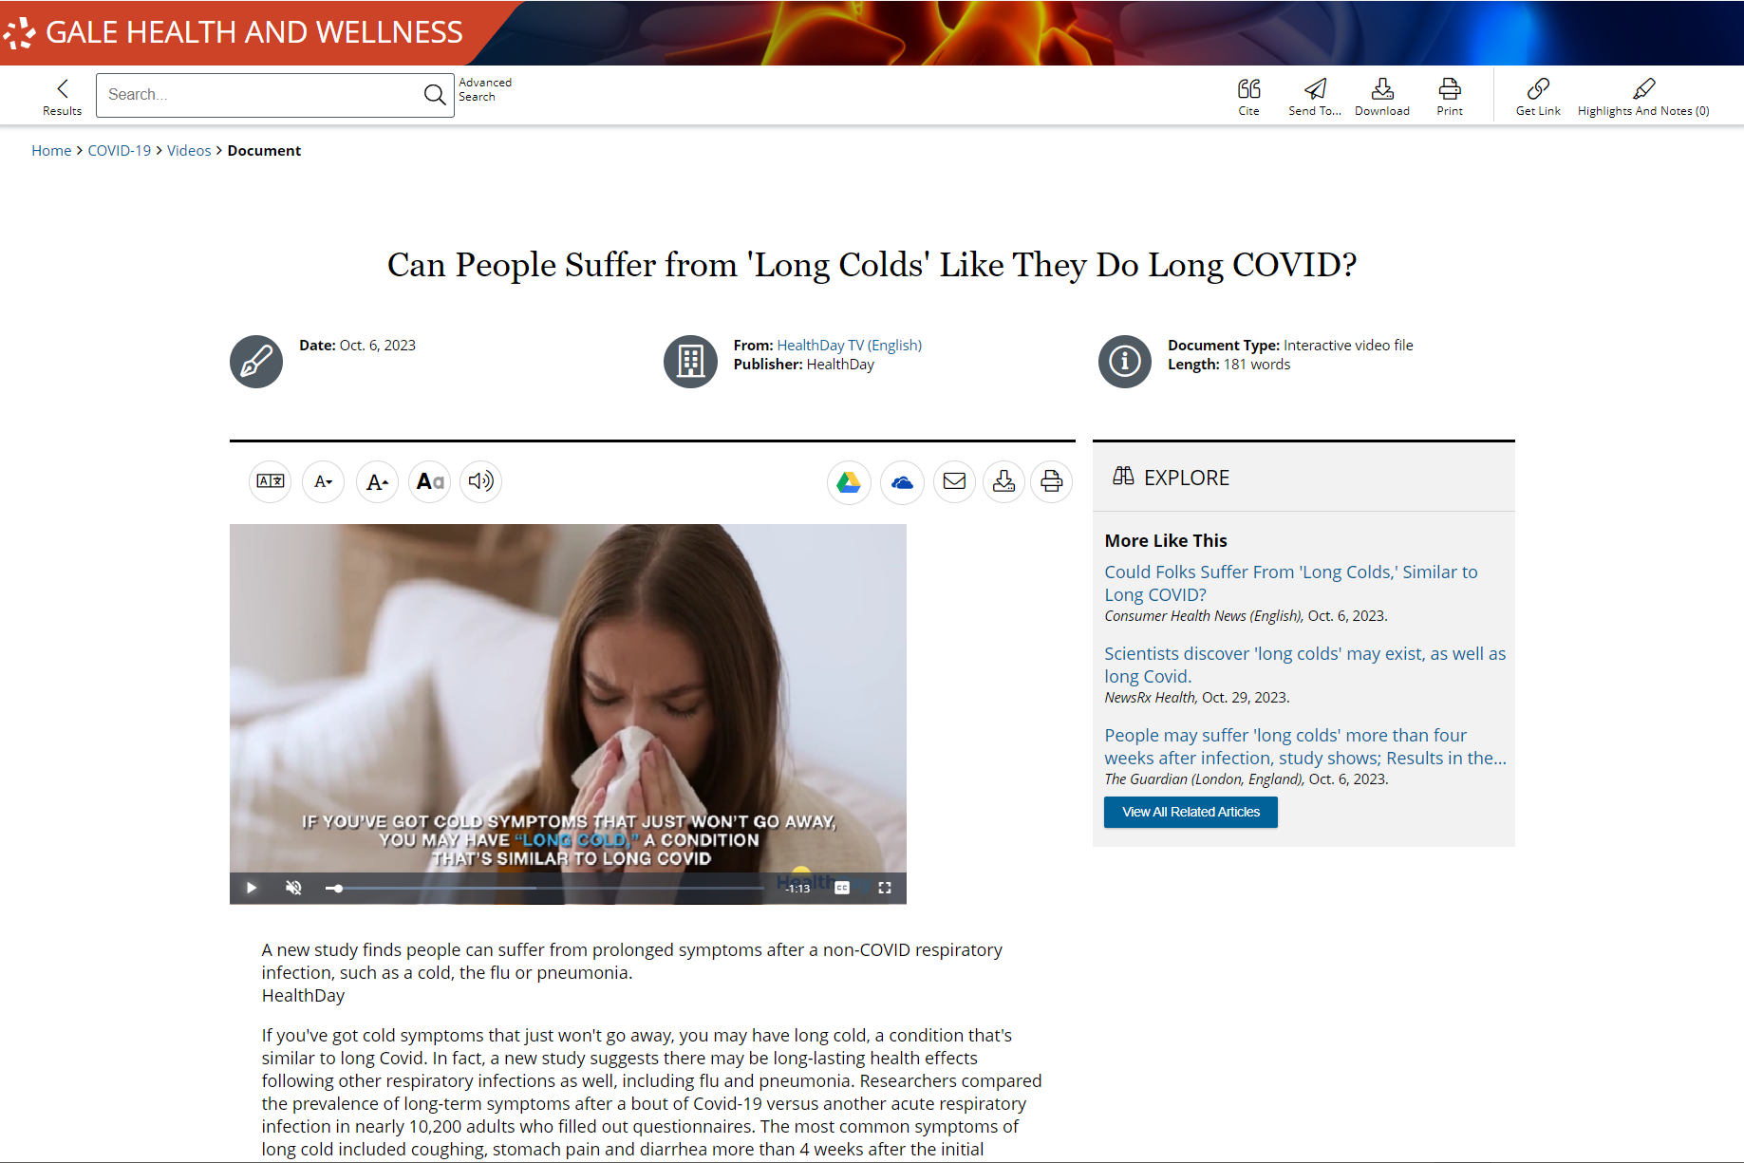
EXPLORE CONTENT: DIRECTORIES
MULTIMEDIA
Video and audio files provide an additional option to access materials
All entries are short (generally under 20 minutes) to ensure continued engagement
Notes:
Multimedia content supports researcher preference to increase accessibility.

Slide 17
ENHANCE RESEARCH

Slide 18
SHARE AND SAVE CONTENT
Get Link, Send To, Download, Print
Collect premium resources to share with colleagues, or save for later
INCREASE ACCESSIBILITY
Translate, Text Manipulation, Listen
Provide options for patrons with varied needs and preferences
SUPPORT RESEARCH
Topic Pages, and Highlights and Notes
Allow patrons to organize research and find key points in consumer health and wellness.
Notes:
These tools support patrons through all stages of research and learning. Patrons will be able to find and save the content they need, access it in the best possible format for them, and highlight important ideas right in their documents.

Slide 19
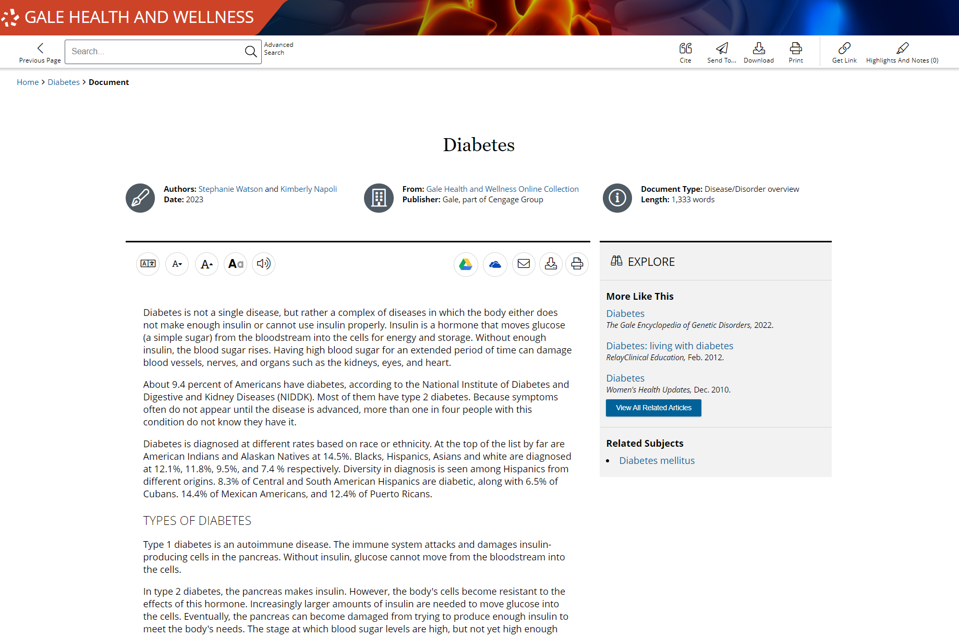
SHARE AND SAVE CONTENT
GET LINK
Create a persistent URL to the page you are on
Notes:
Get Link links are persistent- they won’t break over time. These links are great for you to share with patrons through social media, email lists, or business groups. Patrons can also utilize these links to save their content for later or share the content with peers/ colleagues.
When someone selects a link they will be automatically taken to that page within Gale Health and Wellness. If they decide to navigate through the resource, they will be asked to authenticate in whatever method you have established.

Slide 20
SHARE AND SAVE CONTENT
GET LINK
Create a persistent URL to the page you are on
SEND TO
Send articles to a Google or Microsoft drive, or email
Notes:
Sending materials to Google or Microsoft drive allows your patrons to keep the full text for as long as they want. The content will be sent to whatever drive is signed into on the browser. If a patron hasn’t signed into their account yet, it will prompt them. They can access these tools either in the tool bar at the top of a document page, or in the tool buttons on the right side under the document information.

Slide 21
SHARE AND SAVE CONTENT
GET LINK
Create a persistent URL to the page you are on
SEND TO
Send articles to a Google or Microsoft drive, or email
PRINT AND DOWNLOAD
Print full documents, or download directly to your computer
Notes:
Unlimited printing and downloading allow patrons to access their full text offline.
These buttons are found next to the Send To button in the tool bar and the buttons under the title.

Slide 22
INCREASE ACCESSIBILITY
TRANSLATE
Machine translate both articles and resource navigation
Notes:
Every article includes a simple translation button allowing patrons to choose they language they prefer. Utilizing Set Interface Language will change all the navigation buttons and tools within the platform to the selected language.
To translate an article or the interface select the Translate button found in the set of tools on the left of the screen under the document information.

Slide 23
INCREASE ACCESSIBILITY
TRANSLATE
Machine translate both articles and resource navigation
TEXT MANIPULATION
Edit how article text is viewed by changing the font size, color, style, and spacing
Notes:
Utilizing the text manipulation tools provides for the most customized experience. Patrons can choose their preferences and they will be retained through the duration of their session.
These options are found in the next to the Translate button under the document information.

Slide 24
INCREASE ACCESSIBILITY
TRANSLATE
Machine translate both articles and resource navigation
TEXT MANIPULATION
Edit how article text is viewed by changing the font size, color, style, and spacing
LISTEN
Have entire articles read to you, including title, and any image captions
Notes:
The Listen tool includes options to have words and sentences highlights as they are read, as well as the option to increase or decrease the reading speed. Patrons can download the MP3 to listen to the article on the go.
Access this feature next to the Text Manipulation tools under the document information.
Bonus: The Listen tool will read the article in whatever language it’s translated to. So, if an article has been translated to Spanish by a patron and they then select Listen, they will listen to the text in Spanish.

Slide 25
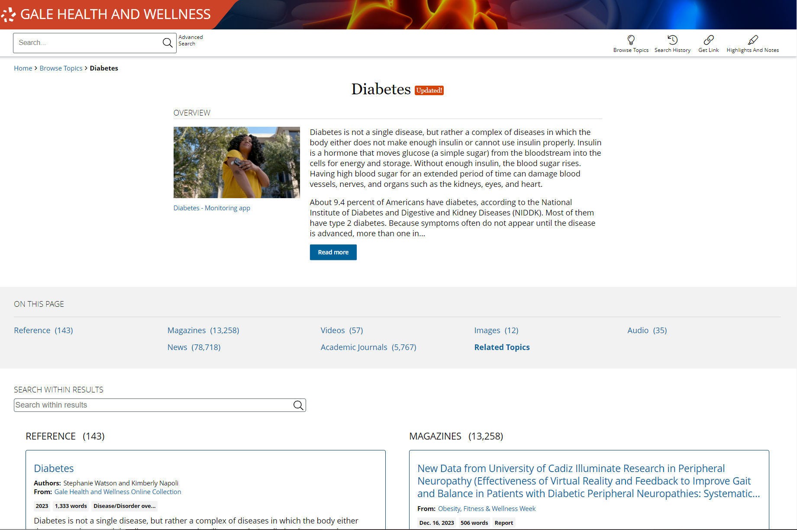
SUPPORT RESEARCH
TOPIC PAGES
Organized pages that provide a topic overview and list all related results
Notes:
Topic Pages can be found in the bottom sections of the homepage. These pages are helpful for patrons who prefer point and click browsing over searching.

Slide 26
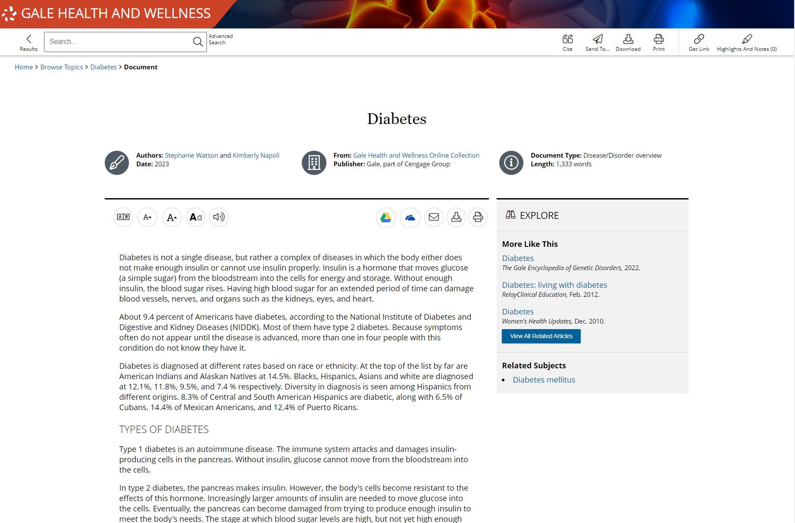
SUPPORT RESEARCH
TOPIC PAGES
Organized pages that provide a topic overview and list all related results
HIGHLIGHTS AND NOTES
All documents can be highlighted and annotated to support a deeper understanding of topics
Notes:
All text results include the option to add highlights and notes. To get started, select text within the document as you normally would to copy or paste text (click and drag on your computer, or tap the first and last word on mobile devices). You’ll then see a pop-out menu that provides color options and the ability to add notes. Choose the desired color for the highlight and add your thoughts to the notes field.
Be sure to take the highlighted item with you before you close the resource by downloading, printing, or sending the item to Google Drive or Microsoft OneDrive. This will provide a copy of the result including any highlights and notes you made within the document.
Note that you can also access the Highlights and Notes menu option in the upper right-hand corner of the resource to access all the highlights and notes you’ve made within a given session. This allows you to easily jump to articles and edit highlights and notes, or to download, print, or send a full list of all your highlights and notes to Google Drive or Microsoft OneDrive. Again, if you plan to use this tool, be sure to download, print, or Send to… before exiting the resource.

Slide 27
?
…
Notes:
Use this slide as a visual prompt for final questions and/or discussions. If you have time, access and walkthrough the platform with attendees.

